Slide 1
Image Super Resolution
25 Jan 2021

Slide 2
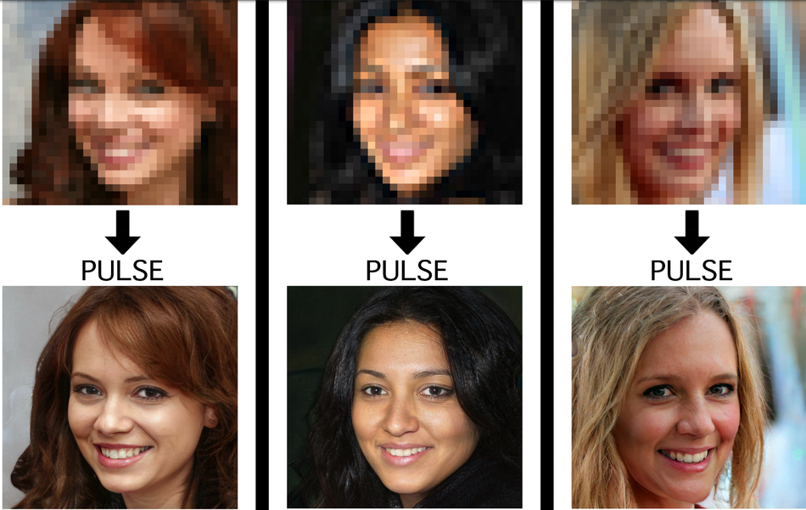
Traditional Techniques
High resolution images have more pixels that we need to fill when upscaling low resolution pictures.
Traditional Image Processing techniques exist (skipped)
Super Resolution is not theoretically possible using IP techniques because we can’t create data by processing

Slide 3
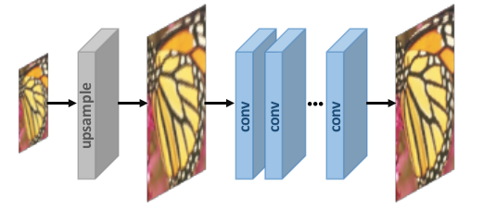
Neural Networks
Input : Low Resolution Image
Output: High Resolution Image
(Generally, done using CNNs)
Limitations
Human perceptions care about image structure and not MSE losses (can use SSIM for minimising content loss)
Once an image is upscaled, we won’t care about exact location of an element. As long as the image looks visually sharp, it is a good image (idea: use GANs)

Slide 4
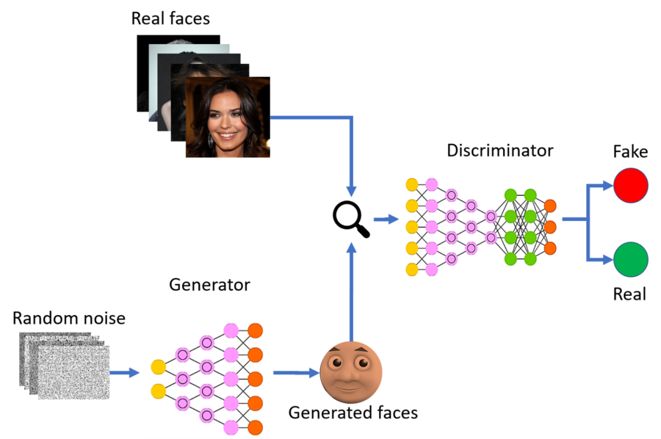
Ways to approach Super Resolution (GANs)
The Idea:
Generator tries to generate High Res. Images and try to fool the discriminator that distinguishes between high and low res images. Once trained, generator is the required model.
Single Frame
Multiple Frame
Task specific

Slide 5
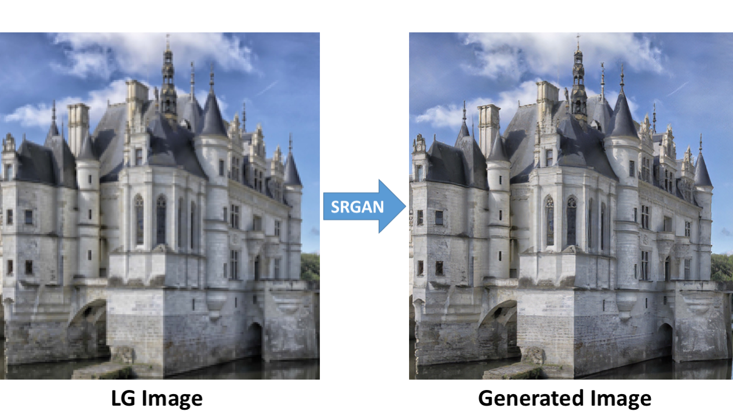
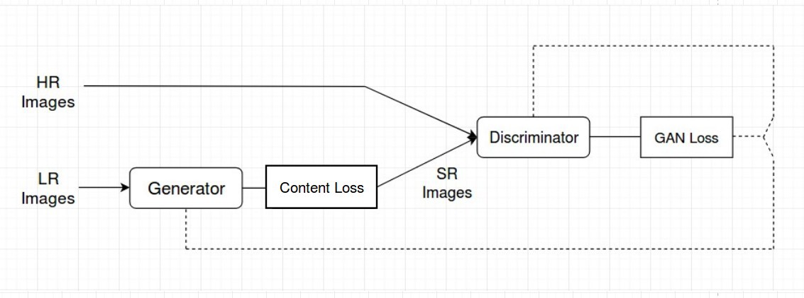
Recent Papers/Models
SRGANs
Faster SRGANs
ESRGANs
RankSRGANs
HiFaceGANs

Slide 6
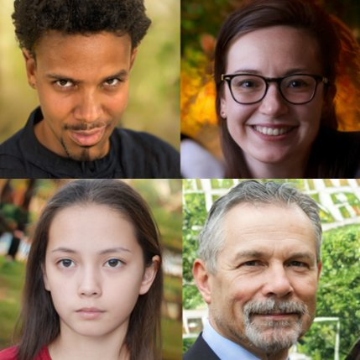
Datasets
General Datasets
DIV2K
DIV8K
Face Datasets
FFHQ

